Slide 1
Welcome to ICSE 2020!

Slide 2
Information
The ICSE website https://conf.researchr.org/home/icse-2020 has links to the following helpful documents
A high-level “map” of the overall program schedule
The detailed program schedule
A video providing details on how to participate in ICSE 2020
Access to ICSE 2020’s Twitter feed and Facebook page
Detailed information about presentations and papers (under “Tracks”)

Slide 3
We thank our Supporters and Sponsors!

Slide 4




Platinum-level Supporters

Slide 5









Gold-level Supporters
Silver-level Supporters
Bronze-level Supporters

Slide 6




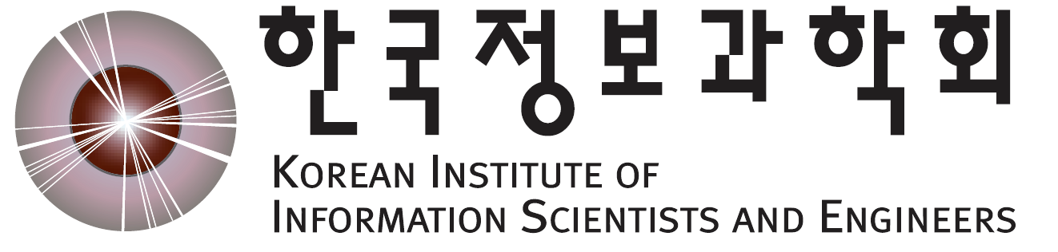
Sponsors

Slide 7
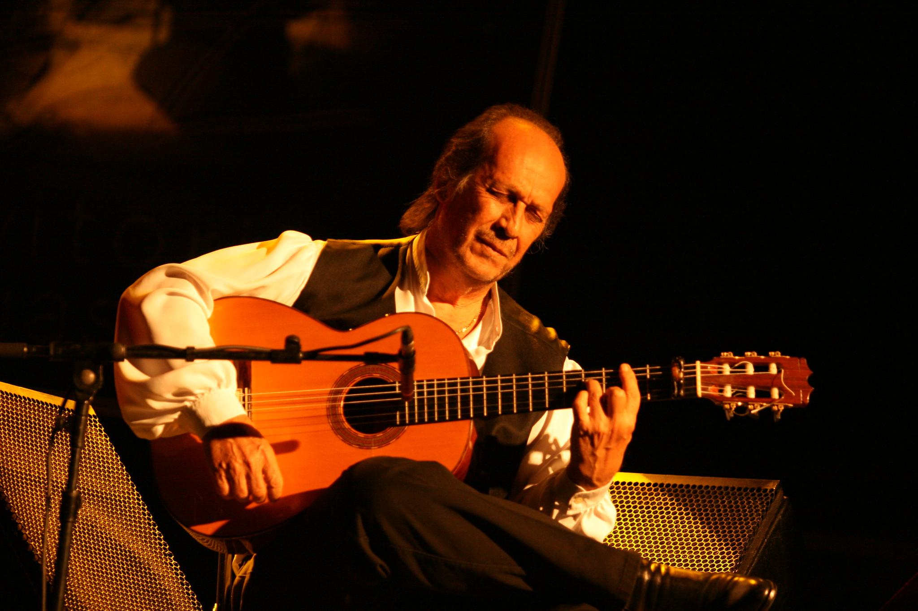
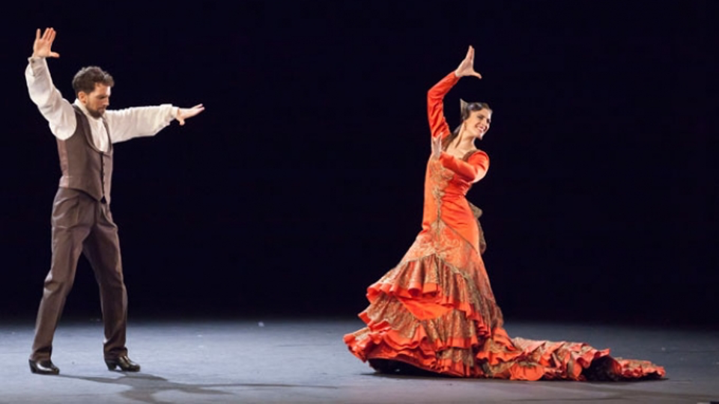
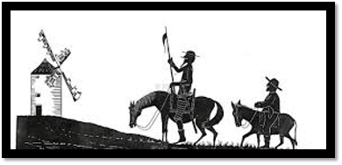
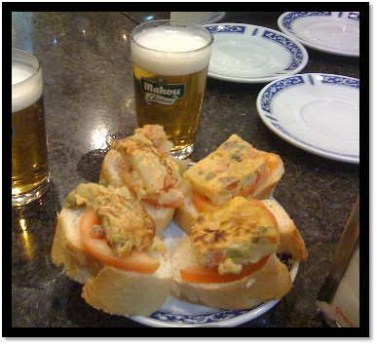
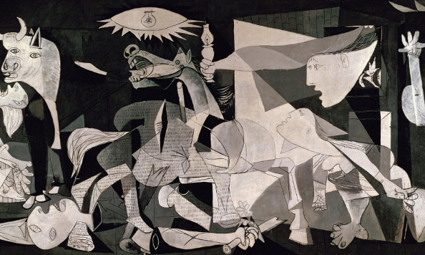
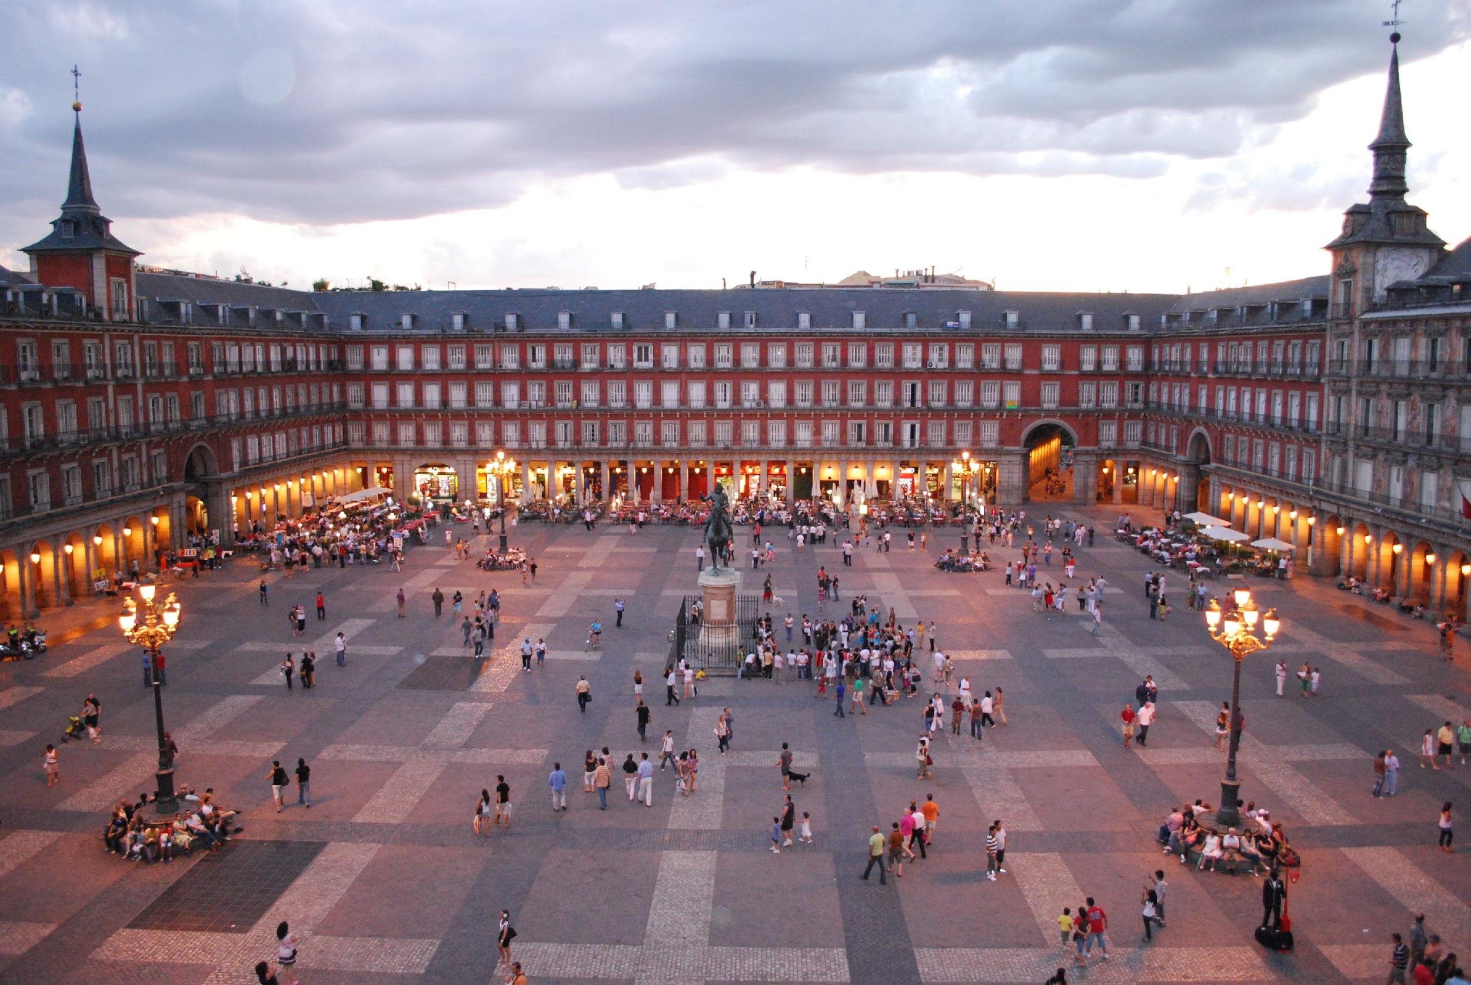
The 43rd International Conference on Software Engineering
May 23-29, 2021 (Main Conference Tue 25-Thu 27)
The 43rd International Conference on Software Engineering (ICSE 2021)
May 23-29, 2021
Main conference Tue 25-Thu 27
Madrid, Spain
Madrid (Spain)

Slide 8
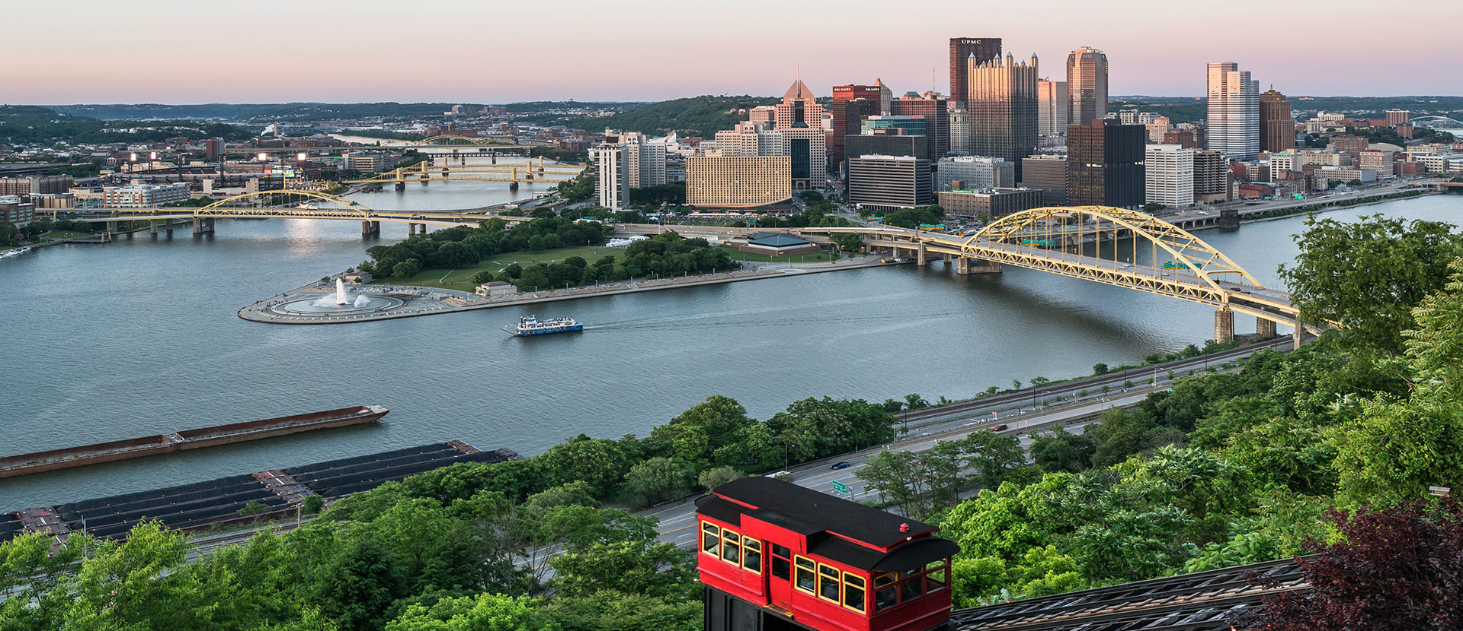
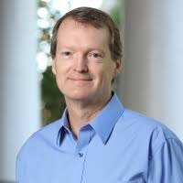
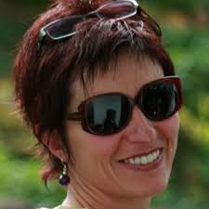
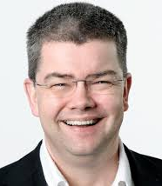
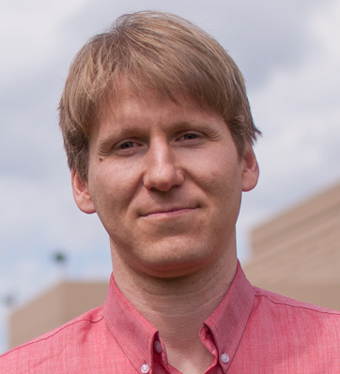
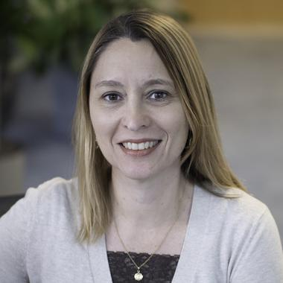
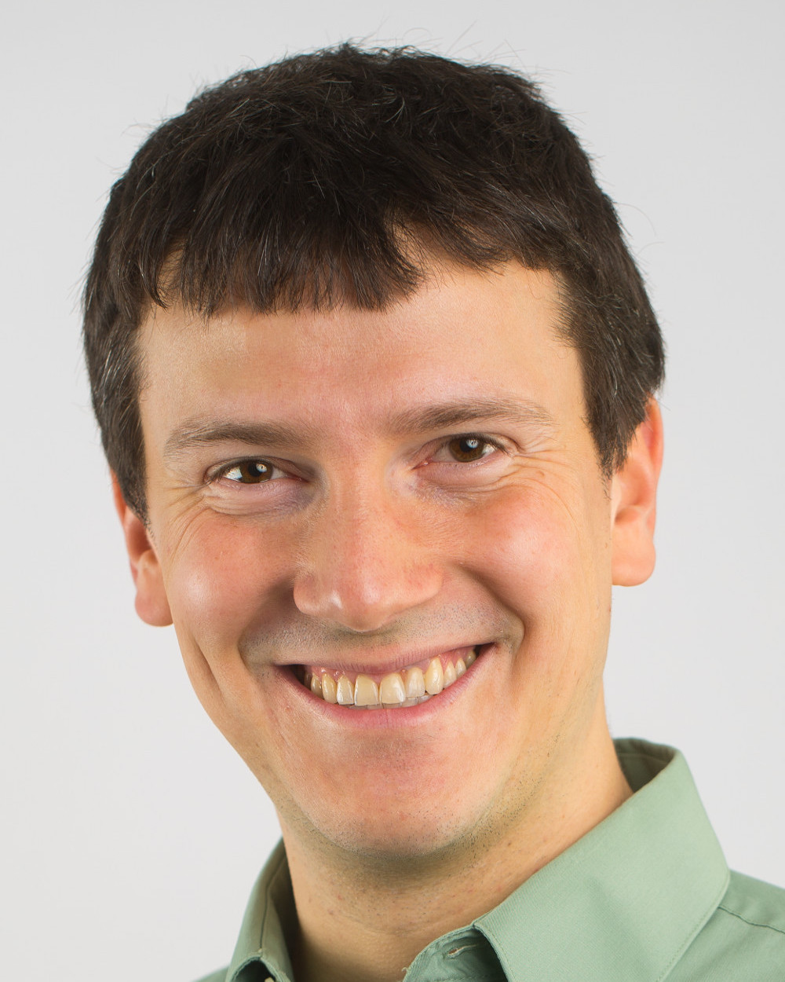
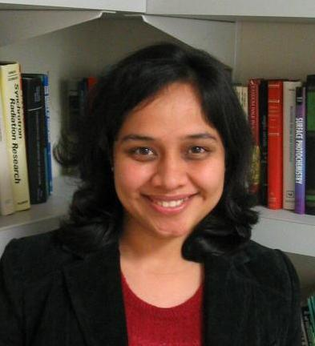
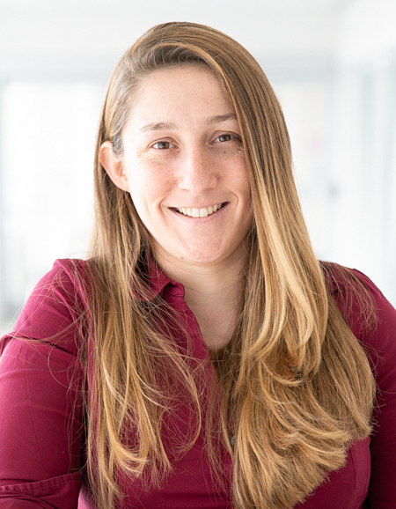
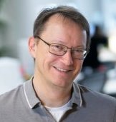
The 44th International Conference on Software Engineering
May 21-29, 2022
Pittsburgh, Pennsylvania, USA
Join us…

Slide 9
Did you Know?
ICSEs “Virtual Rooms” are named after historical Korean kingdoms:
Baekje
Goguryeo
Silla
Tamna

Slide 10
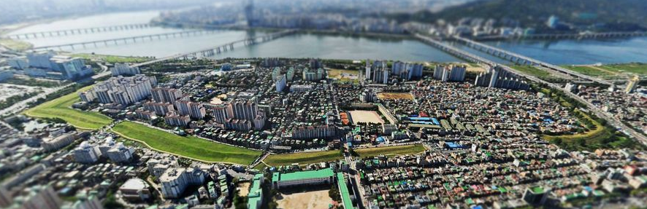
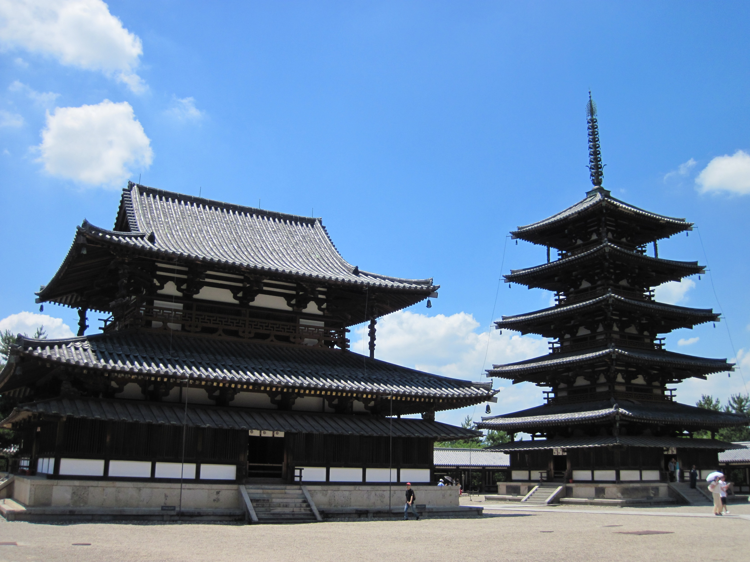
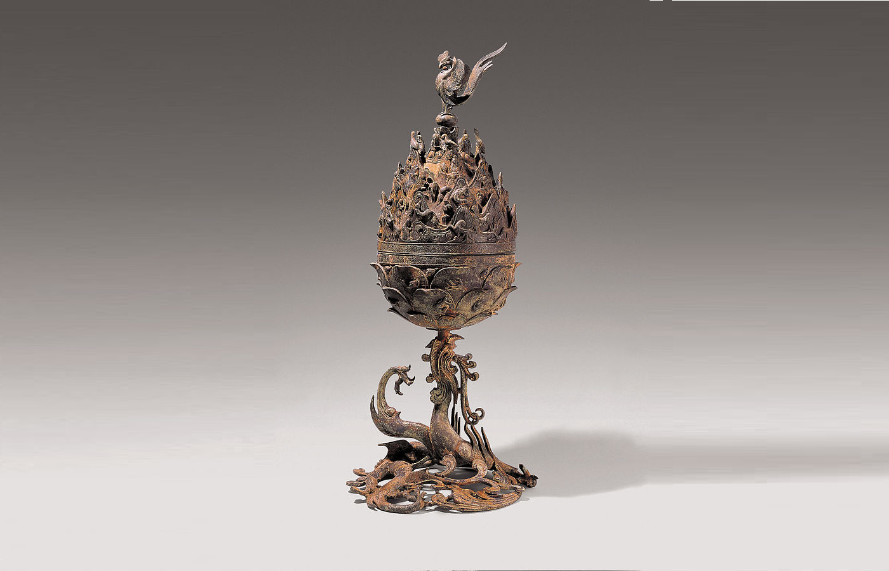
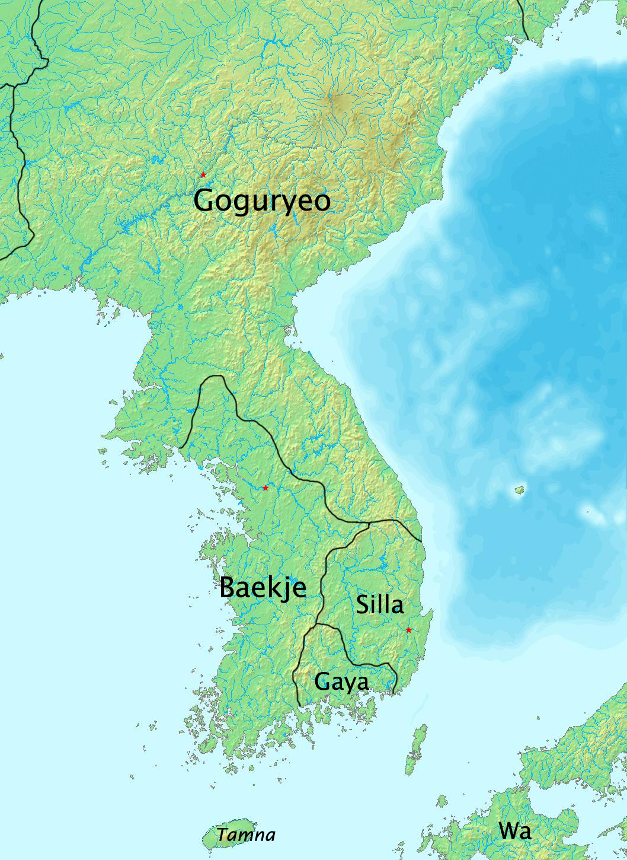
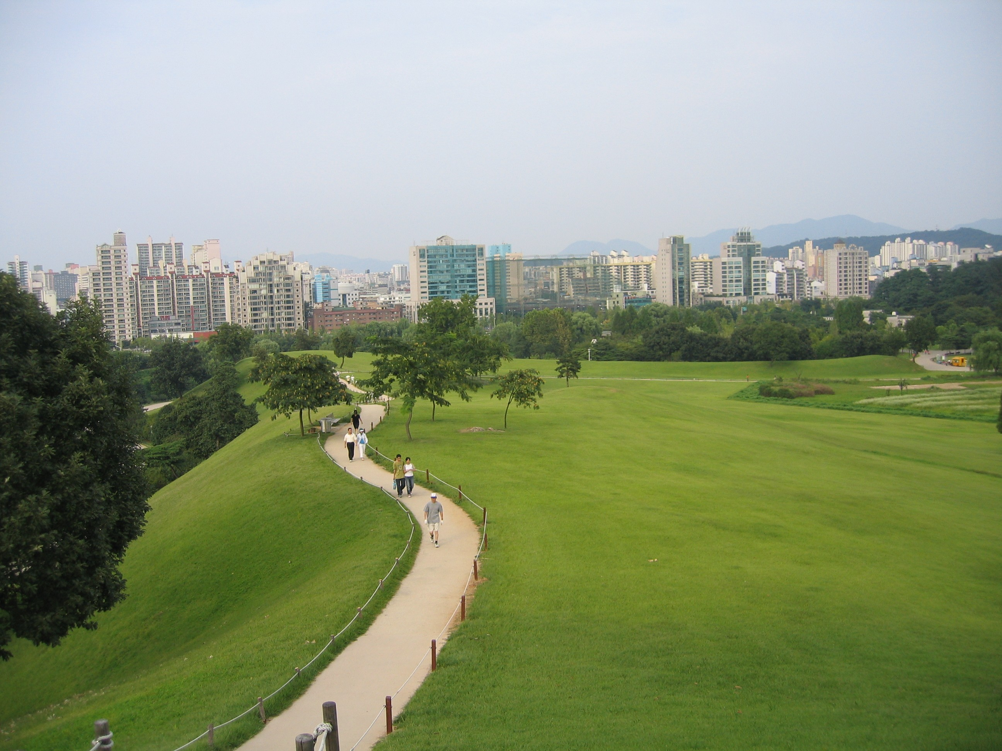
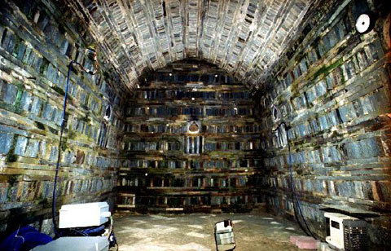
Friend of Japan
Baekje was the first and only country that Japan gave military support in Korean history.
Baekje and Japan were strong allies. There was a Tenno* who is half-Baekje. Also, Baekje gave much cultural influence on Japan. Even some restored Baekje buildings are quite similar to Japanese style like Horyuji.
Pungnaptoseong, which is the first capital of the Baekje. The green zones are the earthen wall.
(Picture by Naver)
Baekje
Horyuji (7th c., Nara, Japan)
(Picture by Wikipedia user Nekosuki)
The First Country that Designated Seoul as Capital.
Buddhism and Taoism
Period | 18 BCE – 660 CE
Capital | Seoul (18 BC~475 AD)
Language | Ancient Korean
Government | Monarchy
Population | 750K (in 7th c.)
Religion | Buddhism
The art of Baekje was based on Buddhism and Taoism.
The burner on the left shows the peak of it. This gilt-bronze burner is gorgeous and very detailed. Experts said it is more beautiful when it burns the incense and emits the smoke.
Gilt-bronze Incense Burner of Baekje
(6th c., Korea)
Tomb of King Muryeong
This tomb was discovered in 1971. It has not been robbed because it was buried entirely, and the mound was too low to think that the slope was the tomb. Lots of artifacts of Baekje was founded.
Without the discovery of the tomb, we cannot know the culture, technology of the Baekje like this.
Mongchontoseong (3rd c., Seoul, Korea)
The first fortress of Baekje.
Baekje at its height at 375 CE
Brother of Goguryeo
Location
Baekje was founded by Onjo, the third son of Goguryeo’s founder Jumong.
Jumong had a left son, Yuri, in Buyeo when he left that kingdom. After Goguryeo was founded, Yuri arrived Goguryeo and became a crown prince.
Onjo left Goguryeo and found their own kingdom in Seoul.
Interior of the tomb of King Muryeong (Korea)
This photo is not taken at the real tomb
but the replica
Baekje was located in southwestern Korea. At its peak in the 4th century, Baekje controlled most of western Korea, as far north as Pyongyang. Some records told that Baekje even held territories in China, but yet controversial.
Three Keys to the Baekje
Baekje changed its name three times in its history.
The correct location of their first capital is not exactly the same as the current Seoul, but the southern part of Seoul.
Japanese Emperor Ganmu was a descendent of King Muryeong of Baekje.
* The emperor of Japan

Slide 11
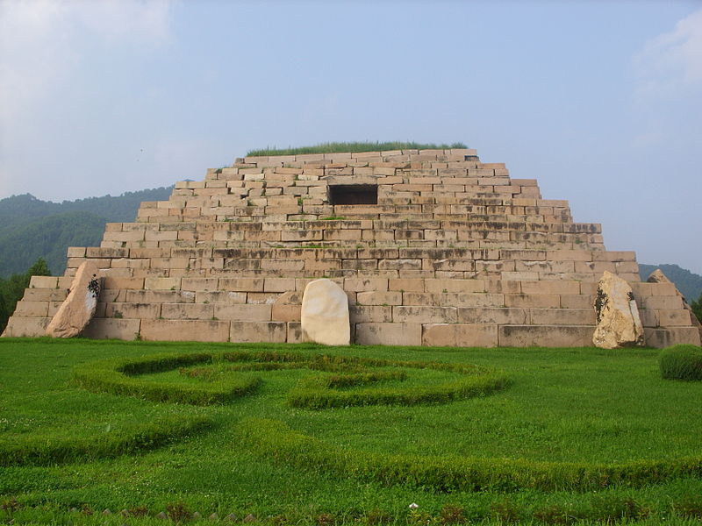
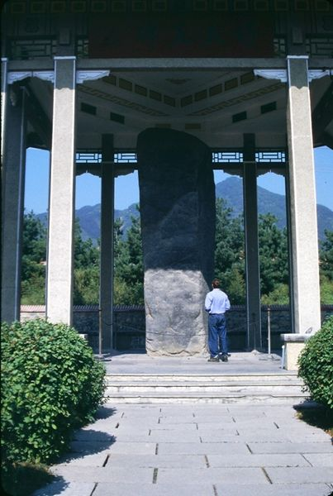
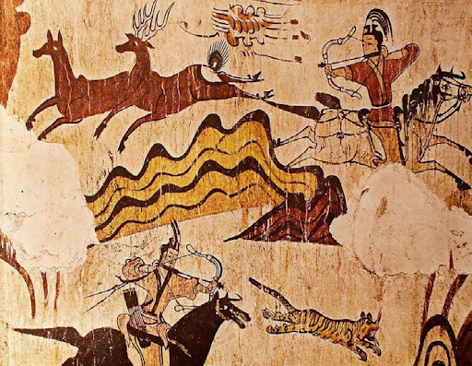
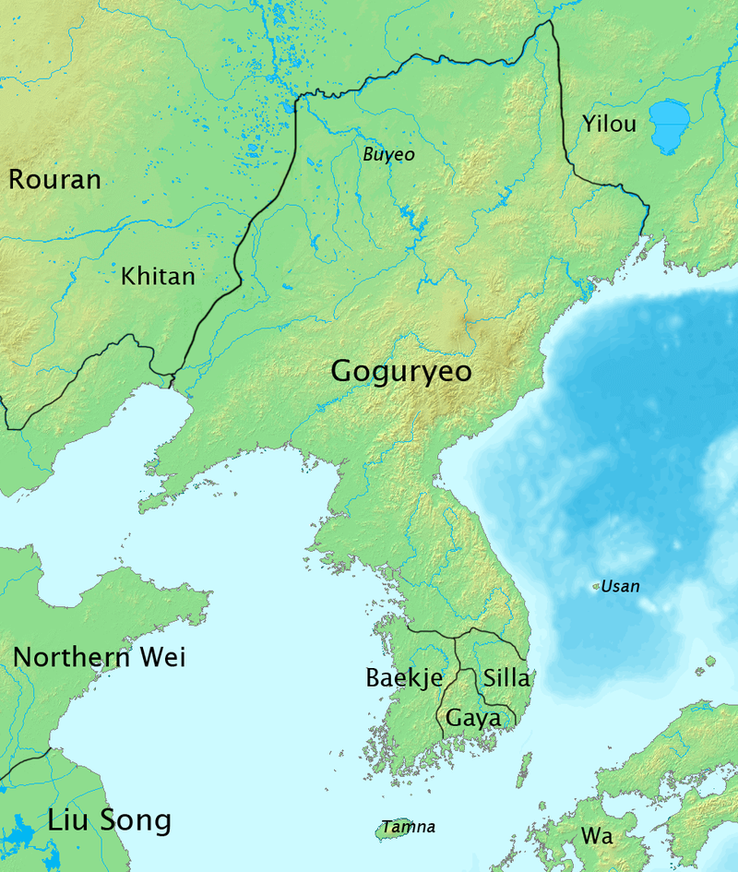
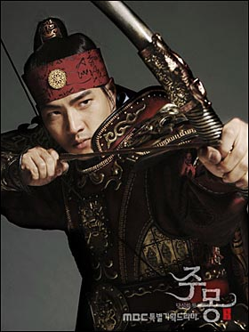
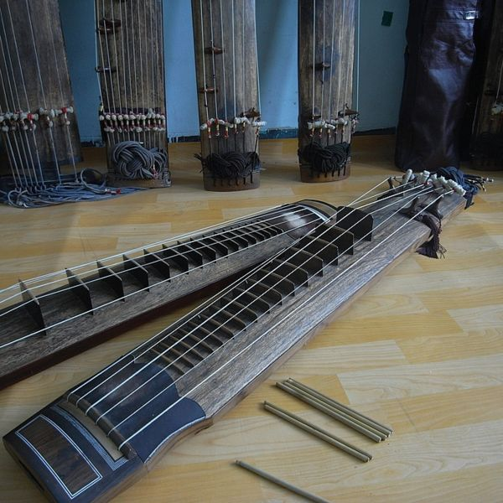
Gwanggaeto, the Great
Goguryeo had its height with the Gwanggaeto the Great.
The Gwanggaeto Stele was built after his tomb for praising his achievements.
Although many letters got erosion, the stele is playing an essential role in researching the 5th century.
The tomb of the general, ancient pyramid of Goguryeo (Jilin, China)
Goguryeo
Gwanggaeto Stele (5th c., Jilin, China)
One of the Northernmost Country in the Korean History.
Mural Paintings
Period | 37 BCE – 678 CE
Capital | Pyongyang (427-678)
Language | Ancient Korean
Government | Monarchy
Population | 3.5M (in 678)
Religion | Buddhism
Most of the remained art pieces of Goguryeo are mural paintings.
Through the paintings, experts revealed the culture, science, and military of Goguryeo.
Goguryeo tombs became the UNESCO World Heritage in 2004.
Mural Paintings of Muyongchong
(5th c., Jilin, China)
Geomungo
Geomungo is a traditional Korean musical instrument.
‘Wang San-ak,’ the prime minister of Goguryeo, invented the Geomungo based on the Chinese instrument, ‘Guqin.’
Geomungo can be found from the Paintings of Muyongchong and Anak Tomb No.3.
Il-gook Song, actor who played ‘Jumong’
Jumong, the First King
Goguryeo at its height at 475 CE
In the 12th c. book, ‘Samguksagi,’ we can find the foundation myth of Goguryeo.
In the story, Jumong was the son of the god with exceptional archery skills. The potentates became jealous, and Jumong was forced to leave.
Thus, Jumong moved to Jolbon, the first capital of Goguryeo, and became King himself.
Location
Traditional Instrument, Geomungo
Goguryeo was located in the northern and central parts of the Korean Peninsula and the southern and central parts of Manchuria. At its peak (475 AD), Goguryeo controlled most of the Korean peninsula and parts of the Russain Far East and Mongolia.
Three Keys to the Goguryeo
‘Goguryeo’ is the origin of ‘Korea’ (‘Goguryeo’ → ‘Goryeo’ → ‘Korea’)
Balhae was founded by refugees from Goguryeo after Goguryeo falls.
Most linguistic experts agree that the Goguryeo language was a member of a Koreanic language family.

Slide 12
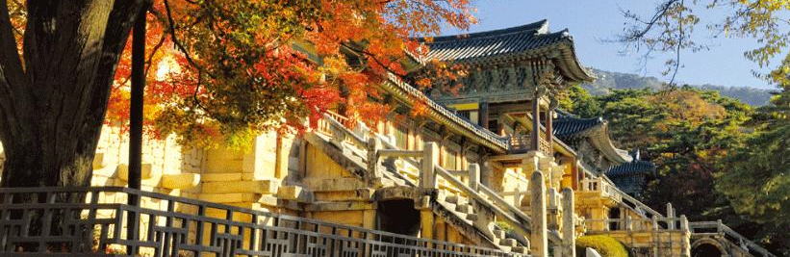
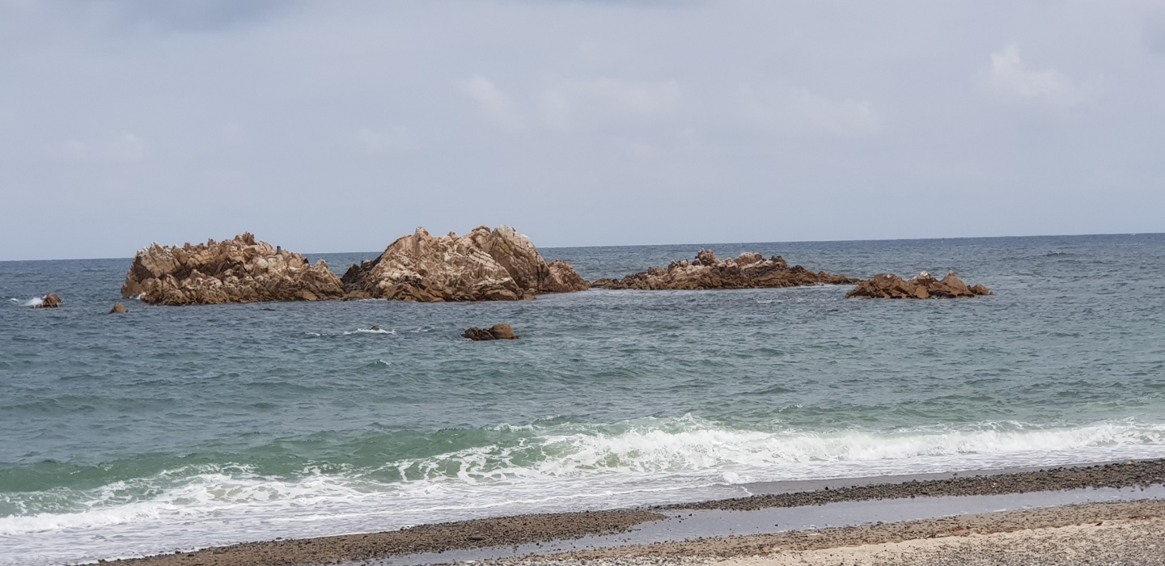
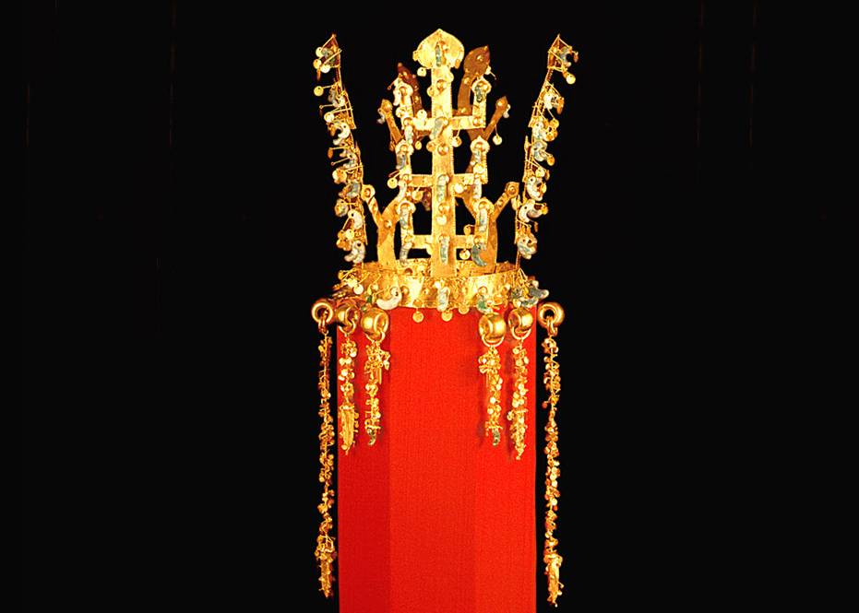
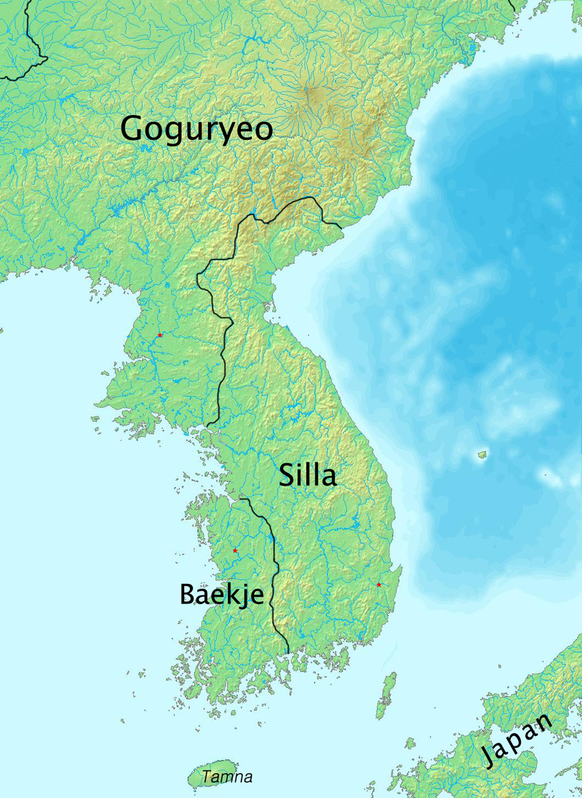
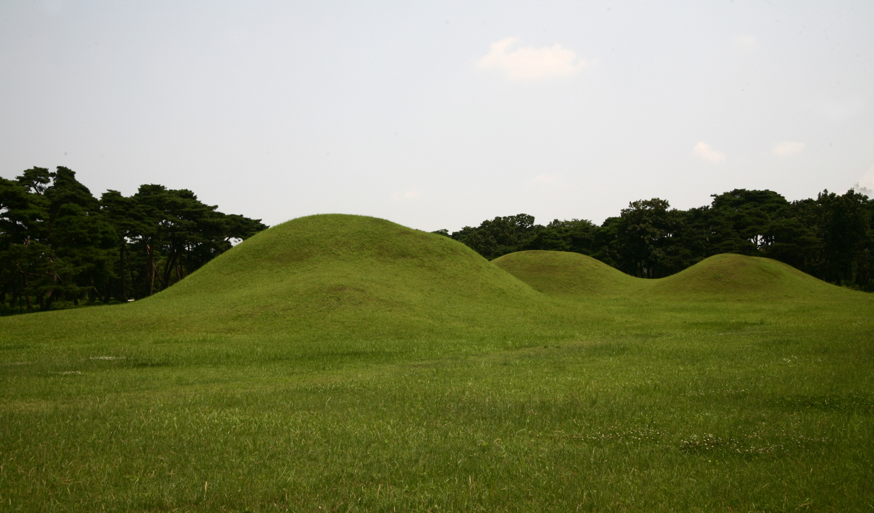
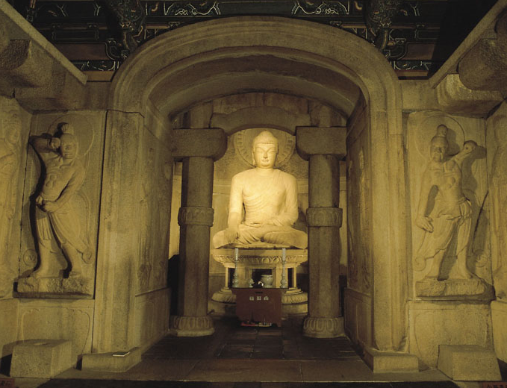
Unification of Korea
Silla was the first unified country in Korean history. By an alliance with Tang of China, Silla defeated Goguryeo and Baekje. However, because of the conflict with Tang, and lack of administration power, Silla lost northern Korea and Manchuria. And there, Balhae was founded by Goguryeo refugees.
Fall of Bulguksa (736, Gyeongju, Korea)
(Picture by Jogye Order of Korean Buddhism)
Silla
Tomb of King Munmu (Gyeongju, Korea)
King Munmu unified Korea for the first time.
Country of Gold, Water and Unification
The Gold Crown
Period | 57 BCE – 935 CE
Capital | Gyeongju
Language | Ancient Korean
Government | Monarchy
Population | 2M (in 8th c.)
Religion | Buddhism
The gold crown of Silla is famous. It is made of very thin gilt. It can be found in lots of tombs of Silla.
It is not appropriate for actual usage. Therefore there are views that the crown is for the funerary.
Golden Crown of Silla (5th c., Korea)
Expertise of Water
Silla was an expert in controlling the water and humidity. They construct a temple or tombs near or on the lake or the sea.
Seokguram is one of them. Silla controlled the humidity and well-maintain it. However, because of the thoughtless restoration of it, it cannot control the humidity right now, so it is dependent on the air conditioner.
Oreung (Gyeongju, Korea)
The tomb of founding fathers of Silla
Silla at its height at 576 CE
Origin of Silla
Location
In the 12th c. book, ‘Samguksagi,’ we can find the foundation myth of Silla.
One day, a horse was crying in the forest. When the village chief got closer to the horse, the horse disappeared, and the big egg was there. The chief broke the egg and found a kid. The kid matured and became the king of Silla.
Seokguram (8th c., Gyeongju, Korea)
Silla was located on the southern and central parts of the Korean Peninsula. Silla ruled most of the peninsula. However, the northern part was for Goguryeo or Balhae.
Three Keys to the Silla
A well-known hypothesis suggests ‘Seoul’ is from the Silla language, ‘Seorabeol,’ which means the capital.
Another hypothesis suggests that the origin of the ‘Seorabeol’ is ‘Silla’, so it has a possibility that ‘Seoul’ and ‘Silla’ has the same origin.
Silla never changed the capital for a thousand years.

Slide 13
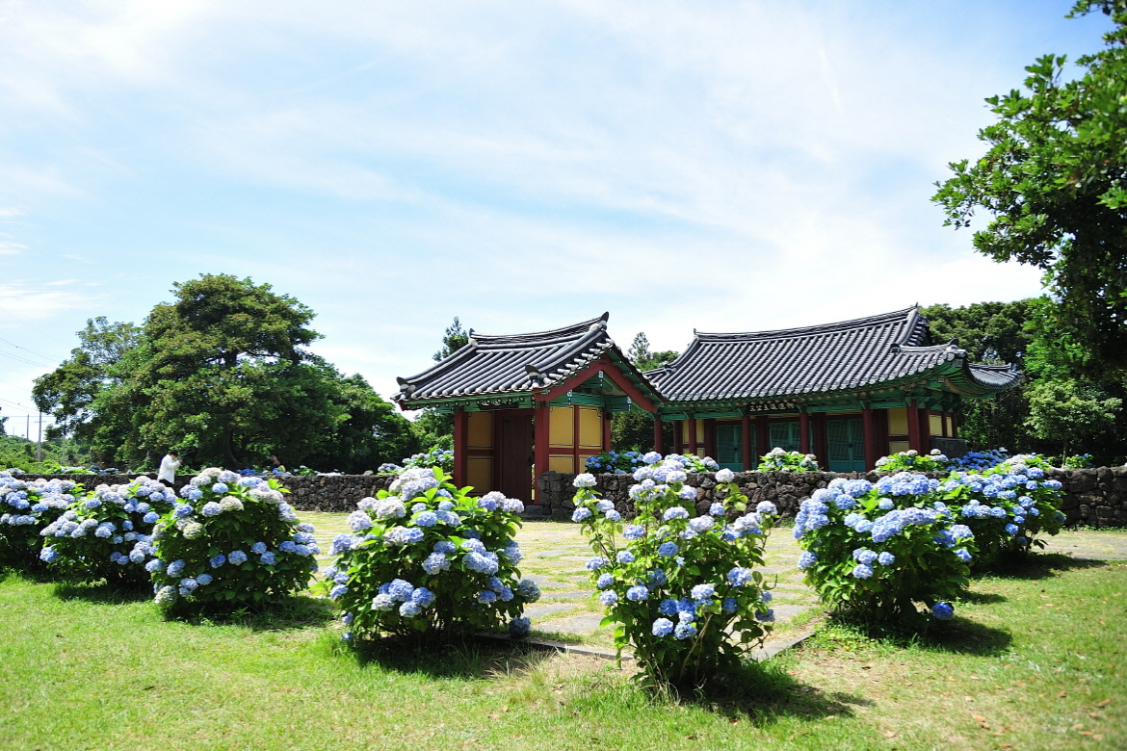


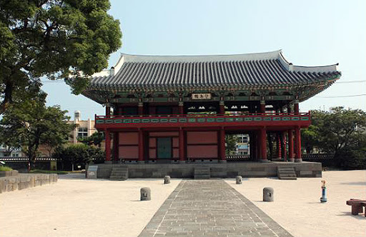
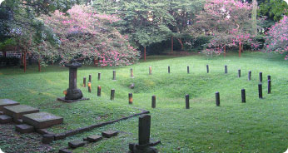
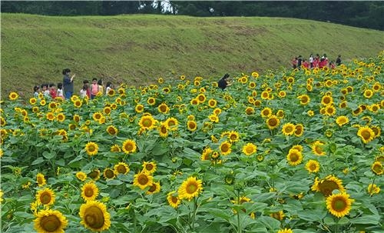
Two Leaders
There were two leaders in Tamna. 'Go' ruled the western side, and 'Ryang' ruled the other.
They heavily fought each other. And the result of the fight was giving up independence, and being a local autonomy administration in Goryeo.
Go
Ryang
Honinji, where the three demigods got marriage (Jeju, Korea)
Tamna
The picture that illustrates two leaders
The Country that Ruled Beautiful Island, Jeju
Anti-Yuan Rebellion
Period | 3rd c.? – 1404
Capital | Jeju
Language | Jeju Language
Government | Tributary State
Population | 100K (in 1400)
Religion | Shamanism
In the 13th century, there was an anti-Yuan rebellion in Tamna, called Sambyeolcho rebellion. They were the army of Goryeo and fight against their invader Yuan.
However, on the side of Tamna, rebels were invaders to them. There were legends that the leader of the rebel suppress the Tamna people.
Office of Jeju Governor of Joseon
(14th c., recovered 2002, Jeju, Korea)
Jeju Island
Goryeo and Yuan controlled Jeju island as autonomy administration with the name ‘Tamna.’
The first time that not using ‘Tamna’ for the island was Joseon. Joseon erased the name ‘Tamna,’ and ruled with the new name ‘Jeju.’ With the new name, Tamna assimilated into Korea.
Samseonghyeol. (Jeju, Korea)
Legend tells demigods emerged here.
Jeju Island
Three Eulna Legend
Location & History
According to the legend, three demigods emerged from the ground and became the founding fathers of Tamna.
These three demigods – Eulnas are ‘Go Eulna,’ ‘Ryang Eulna,’ ‘Bu Eulna.’ Since the Go, Ryang, Bu are very rare surname in Korea, people who have these surname mostly have ancestors from Jeju.
Historical site of Anti-Yuan rebellion.
(Jeju, Korea, picture by Yonhap News)
Tamna ruled Jeju Island until Joseon Dynasty ruled it in 1404. Before the Joseon rules, Tamna ruled Jeju as a tributary state or local autonomy administration of Baekje, Silla, Goryeo, and Yuan for thousand years.
Three Keys to the Tamna
Some experts think the Tamna means the island country – Tam as an island, and Na as a country.
It’s hard to find the archaeological site of Tamna.
Dol hareubang, a well-known statue in Jeju, is not from Tamna.

Slide 14
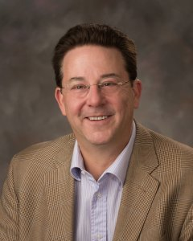
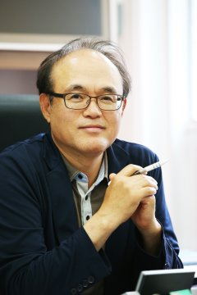
ICSE 2020 General Chairs
Gregg Rothermel
General Co-Chair
Doo-Hwan Bae
General Co-Chair

Slide 15
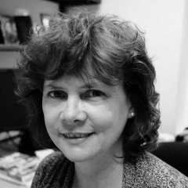
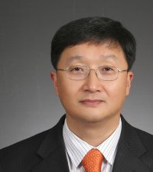
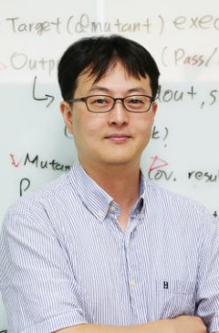
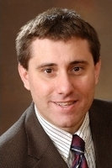
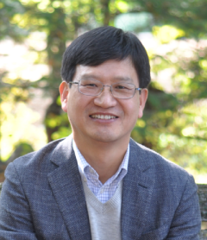
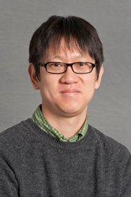
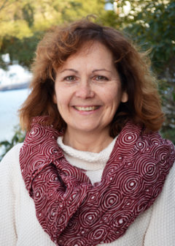
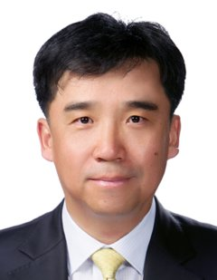
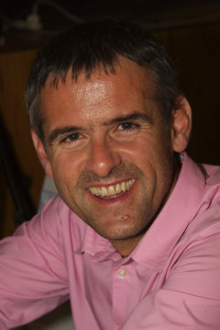





ICSE 2020 Organizing Committee
Jane Cleland-Huang
Program Co-Chair
Steve Cha
Co-Located Events Co-Chair
Moonzoo Kim
SEIP Chair
Darko Marinov
Program Co-Chair
Jang-Eui Hong
Korean Co-Located Events Co-Chair
Shin Yoo
NIER Co-Chair
Lori Pollock
Workshops Co-Chair
Byungjeong Lee
Korean Co-Located Events Co-Chair
Willem Visser
NIER Co-Chair
Miryung Kim
Workshops Co-Chair
Sungwon Kang
JSEET Co-Chair
In-Young Ko
Finance Chair
Wei Le
Co-Located Events Co-Chair
Amy Ko
JSEET Co-Chair

Slide 16















Seok-Won Lee
SEIS Co-Chair
Eunjee Song
Technical Briefings Co-Chair
Collin McMillan
Poster Co-Chair
Anita Sarma
SEIS Co-Chair
Hyunsook Do
Demonstrations Co-Chair
Tingting Yu
Poster Co-Chair
Tien N. Nguyen
Demonstrations Co-Chair
Xiangyu Zhang
Track Scheduling Chair
Andrian Marcus
Journal First Co-Chair
Mike Papadakis
Journal First Co-Chair
Tim Menzies
Artifact Evaluation Co-Chair
Ben Hermann
Registration Chair
Sam Malek
Technical Briefings Co-Chair
Leandro Minku
Artifact Evaluation Co-Chair
Yeong-Seok Seo
Exhibitions Chair
ICSE 2020 Organizing Committee

Slide 17















Mauro Pezze
New Faculty Symposium Co-Chair
Junbeom Yoo
Student Research Competition Co-Chair
Shin Hong
Web Co-Chair
Mary Lou Soffa
New Faculty Symposium Co-Chair
Alessandro Orso
Awards Chair
Lingming Zhang
Social Media Co-Chair
Lionel Briand
Doctoral Symposium Co-Chair
William G.J. Halfond
Proceedings Co-Chair
Donghwan Shin
Social Media Co-Chair
Gail Murphy
Doctoral Symposium Co-Chair
René Just
Proceedings Co-Chair
Prem Devanbu
MIP Award Co-Chair
Andrew Begel
Student Research Competition Co-Chair
Milos Gligoric
Web Co-Chair
Sebastian Uchitel
MIP Award Co-Chair
ICSE 2020 Organizing Committee

Slide 18















Michael Vierhauser
Submissions Chair
Jongmoon Baik
Sponsorship Chair
Kyungmin Bae
Publicity Co-Chair
Sang Kil Cha
Student Volunteer Co-Chair
Yunja Choi
Student Mentoring Workshop Co-Chair
Eunjong Choi
Publicity Co-Chair
José Miguel Rojas
Student Volunteer Co-Chair
Christian Kästner
Student Mentoring Workshop Co-Chair
Miran Lee
Publicity Co-Chair
Hamid Bagheri
Student Volunteer Co-Chair
Shane McIntosh
Student Mentoring Workshop Co-Chair
Reda Bendraou
Publicity Co-Chair
Carolyn Seaman
Student Volunteer Co-Chair
Sandeep Kuttal
Travel Grants Chair
John L. Singleton
Publicity Co-Chair
ICSE 2020 Organizing Committee

Slide 19











Kihong Heo
Regional Live! Team Leader
David Shepherd
Social Events
Otavio Lemos
Youtube Team Leader
Sebastian Proksch
Regional Live! Team Leader
Kihong Heo
Social Events
Donghwan Shin
Youtube Team Leader
Iftekhar Ahmed
Regional Live! Team Leader
Paris Avgeriou
Social Events
Oscar Dieste
Regional Live! Team Leader
Jonathan Bell Virtualization Technology
Crista Lopes
Virtualization Chair
Xin Peng
Regional Live! Team Leader
Jeehoon Kang
Virtualization Technology
ICSE 2020 Virtualization Team

Slide 20




This live-stream was brought to you by:
Silvia Abrahão
Zoomer
Claudia Ayala
Zoomer
Carolin Brandt
OBS Streamer
Rodrigo Fonseca
Zoomer
Mehdi Keshani
OBS Streamer
Oscar Dieste
Zoomer
Marc Oriol
Zoomer
Ignacio Panach
Zoomer
Amir Mir
OBS Streamer
Pilar Rodríguez
Zoomer
Sergio Segura
Zoomer
Maliheh Izadi
OBS Streamer
Martín Solari
Zoomer
Sebastian Proksch
OBS Streamer
Image credits: Clap Vectors by Vecteezy, Break music: https://www.bensound.com

